Slide 1

Dr. D. Y. Patil Institute of Technology , Pimpri
Presented by (Group No. 14)
Mr.Shashank Sameer Joshi (Roll No. BMHC03)
Mr. Dineshkumar Dhanappa Vhankade (Roll No.BMHC04)
Miss. Sneha Vitthal Koli (Roll No. BMHC07)
Miss. Kirtee Pralhad Dubal (Roll No.BMHC11)
Under the Guidance of
Dr. Sumit Desai
Project Topic :Design and development of XY axis drawing robot
(Sponsored by iTech Robotics & Automation Pvt. Ltd.)

Slide 2
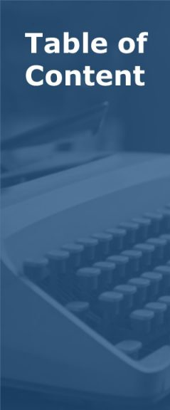
1
INTRODUCTION
2
PROBLEM STATEMENT
3
LITERATURE REVIEW
4
OBJECTIVES
5
POSSIBLE OUTCOMES
6
REFEERENCES

Slide 3
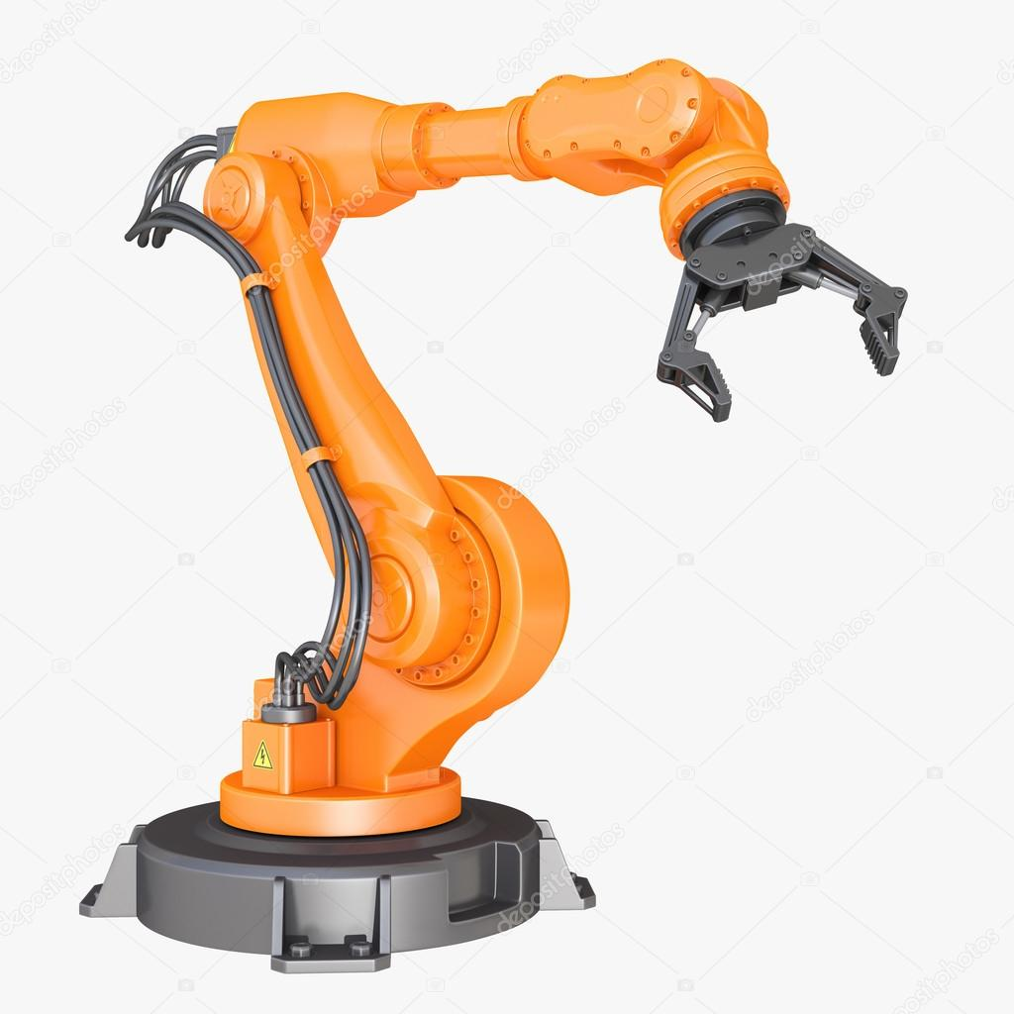
INTRODUCTION OF ROBOT
What is robot?
A robot is a type of automated machine that
Can execute specific tasks with little or no human intervention and with speed and precision.

Slide 4

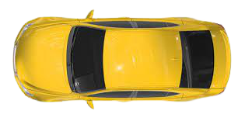

PNG→SVG
Processing → G-Codes
Arduino → Electric Signal
E-Signal → Mechanical O/p
Result→ Drawing

Slide 5
Problem statement
01
can draw any sketch of various sizes.
02
Functioning/Execution of the
program as per requirement.
Develop a robot
which
Can perform its function
with less errors
03
Easy to operate with
less input requirements
04
Can be fitted in less time
& easy to install.
05
06
Validation of the actual sketch drawn with input

Slide 6
Objective 2
Objective 1
To develop a robot which is easy to operate & install
To develop a robot which can draw any sketch based on i/p
Objective 3
To design a robot which is light in weight & low in cost
Objective 4
objective
To make it portable, can be operate from anywhere

Slide 7
POSSIBLE OUTCOMES
Procurement of required parts for project
Preparation of assembly drawing & part drawings.
Printing of main pen holder part & support brackets.
Assembly of the all parts on board.
Connections & source code, software installation.

Slide 8
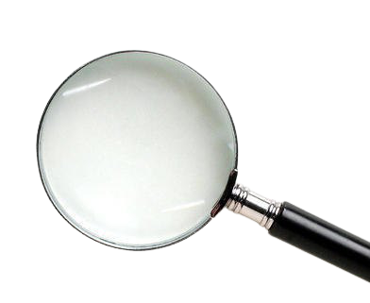
References
Problem statement provided by iTech Robotics & Automation Pvt. Ltd

Slide 9
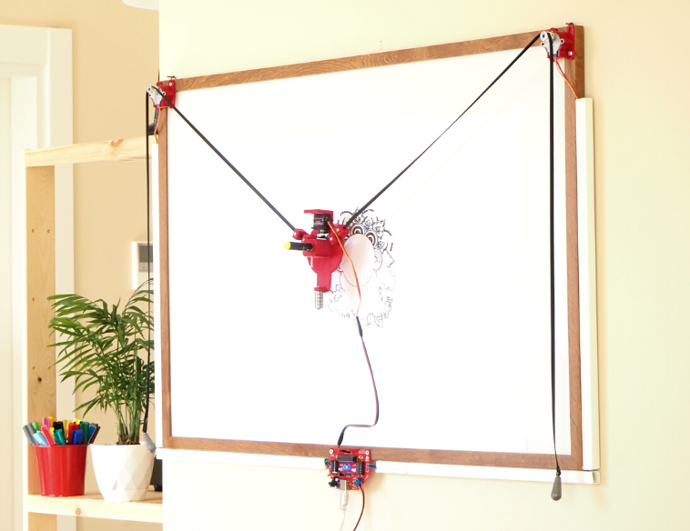
Actual project photo

Slide 10
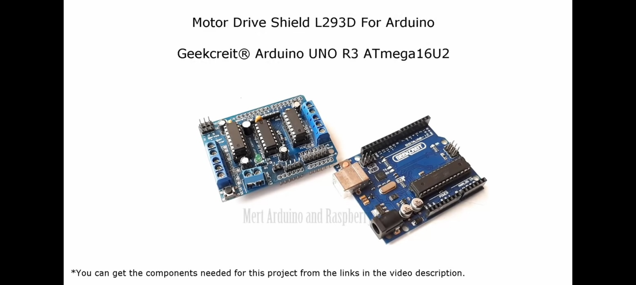
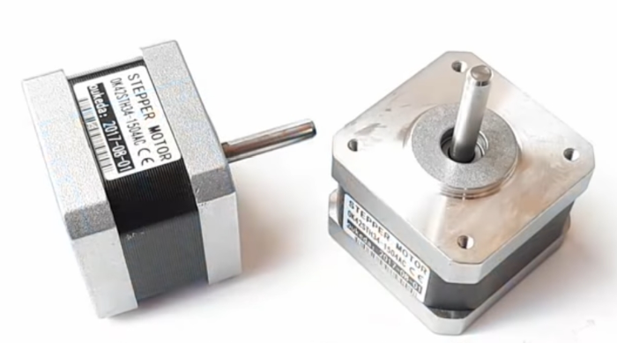
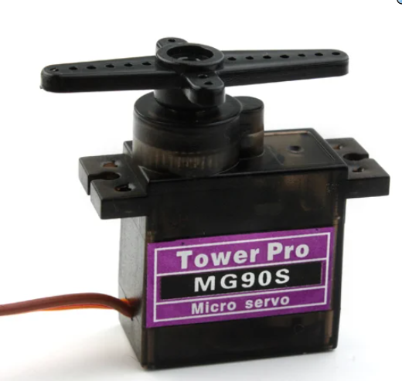
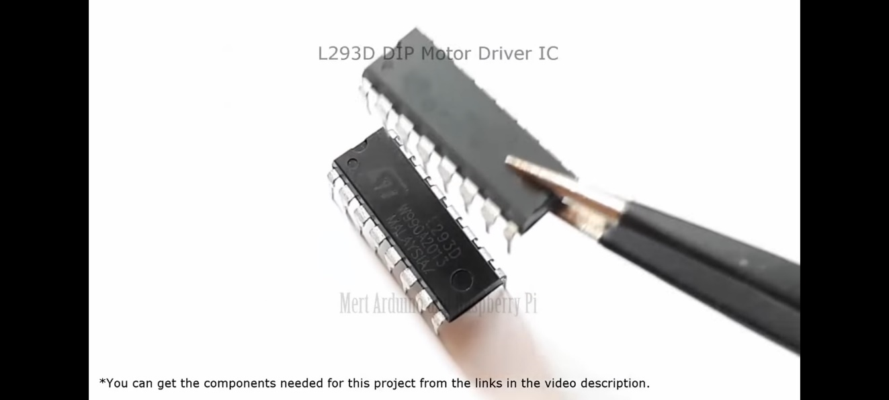
All components :
Arduino Board UNO R3 | 17 stepper motor
Servo motor MG90S | Motor Driver IC L293D

Slide 11
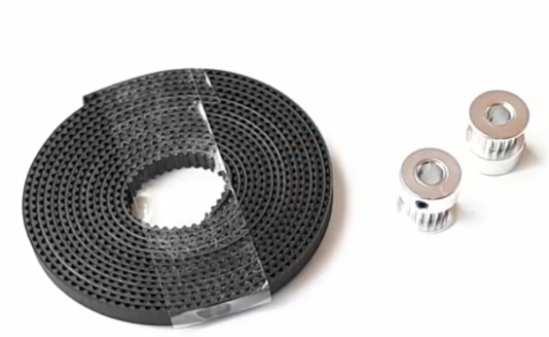
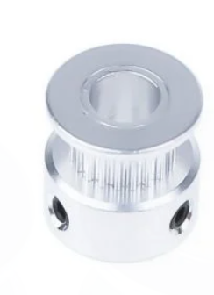
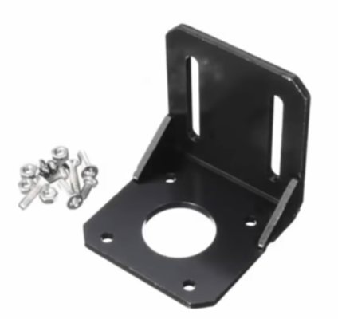
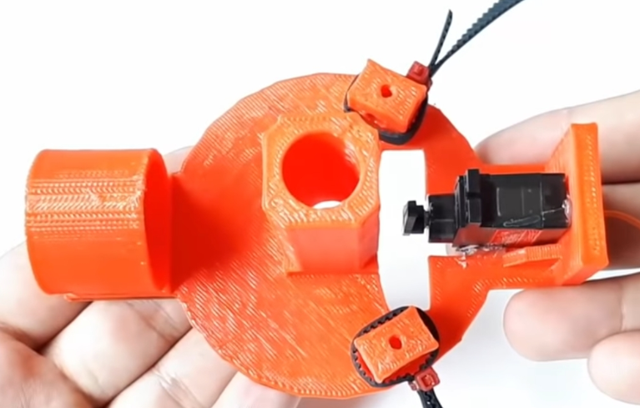
All Components
GT2 Rubber Belt | GT2 16 teeth Pulley
Mounting bracket | Pen Holder

Slide 12
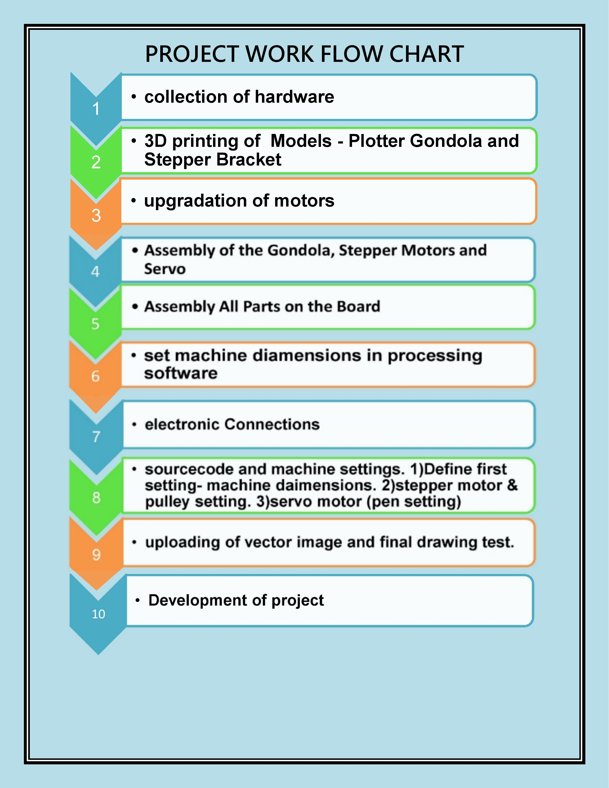


Slide 13
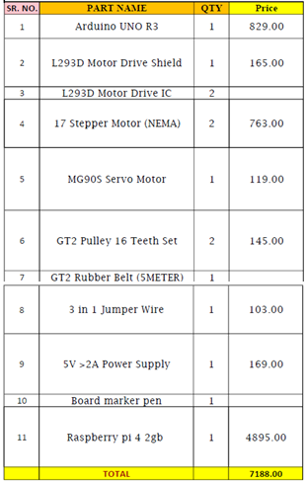
Bill Of Material

Slide 14
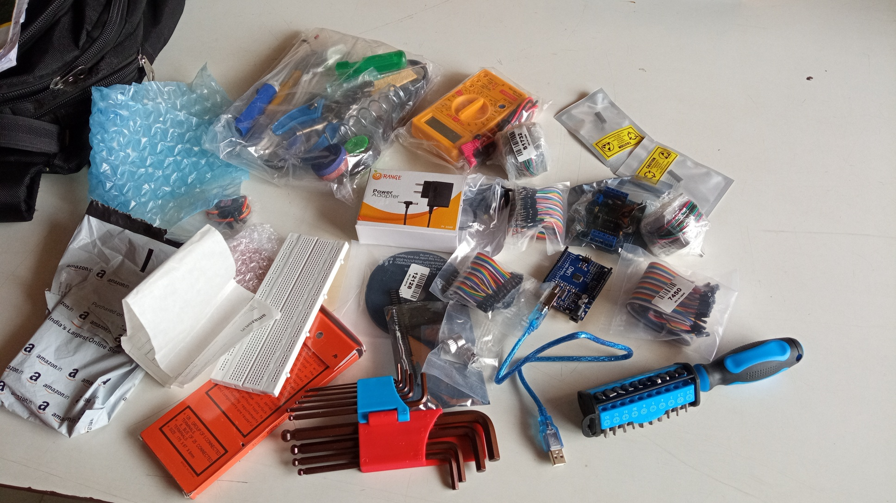
Collected hardwares

Slide 15
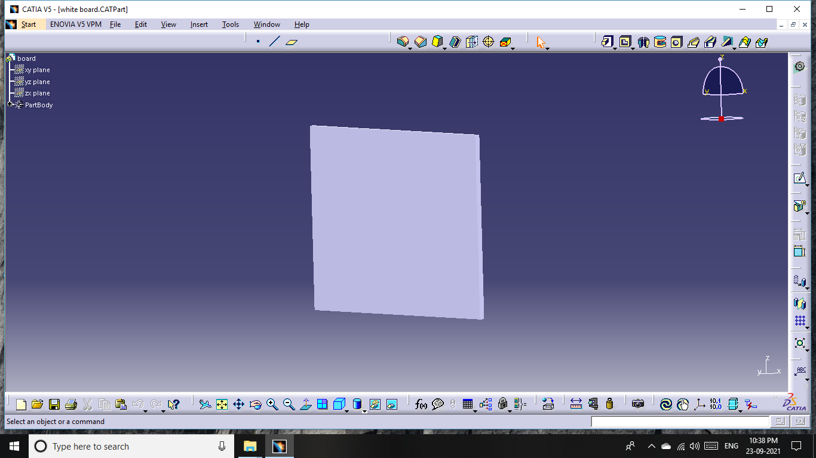
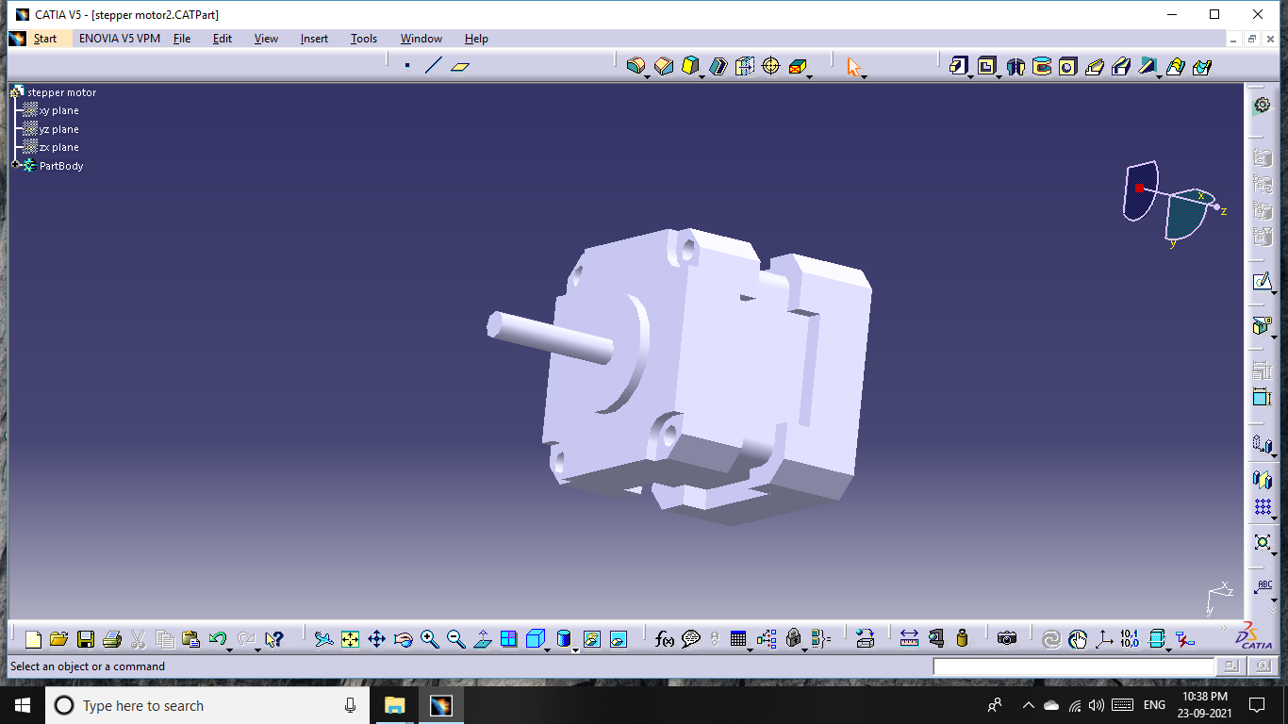
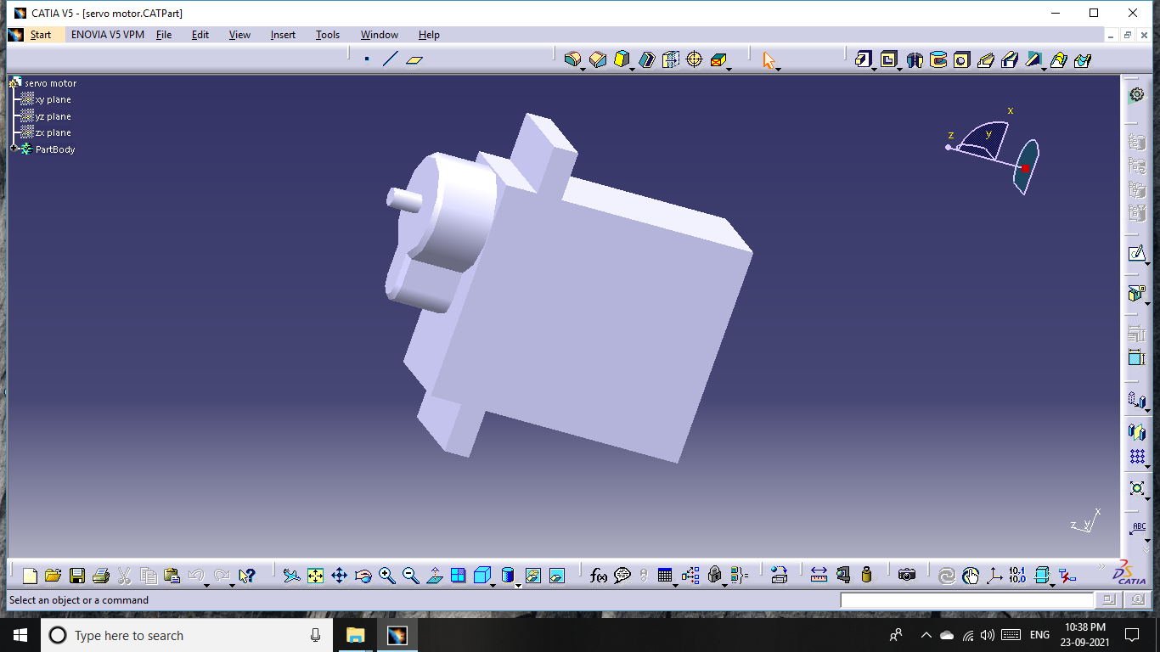
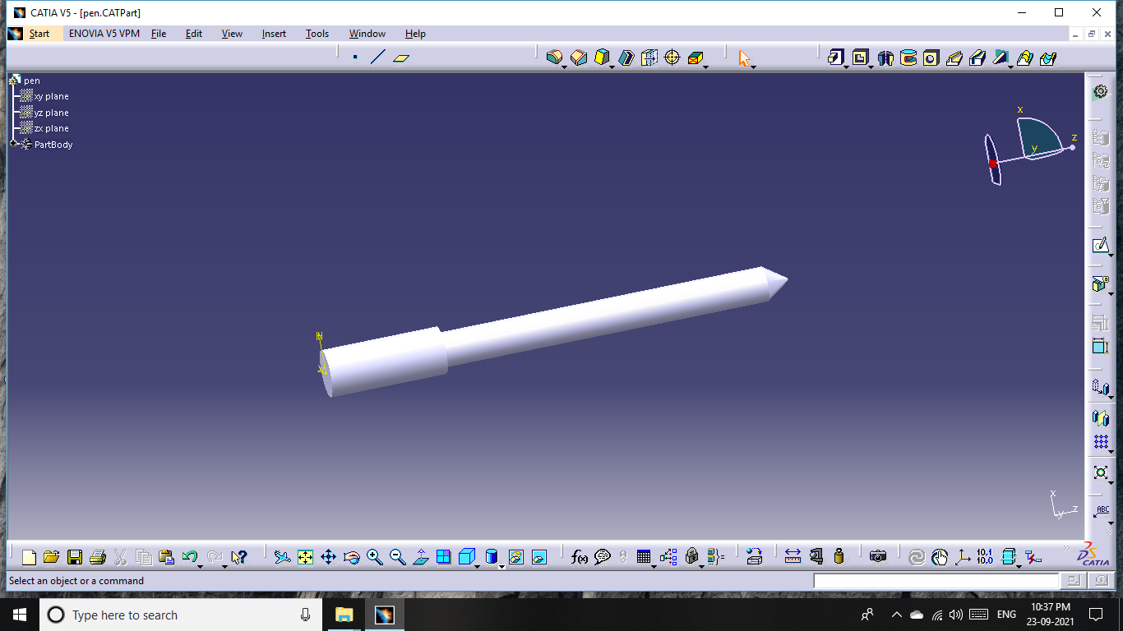

Slide 16
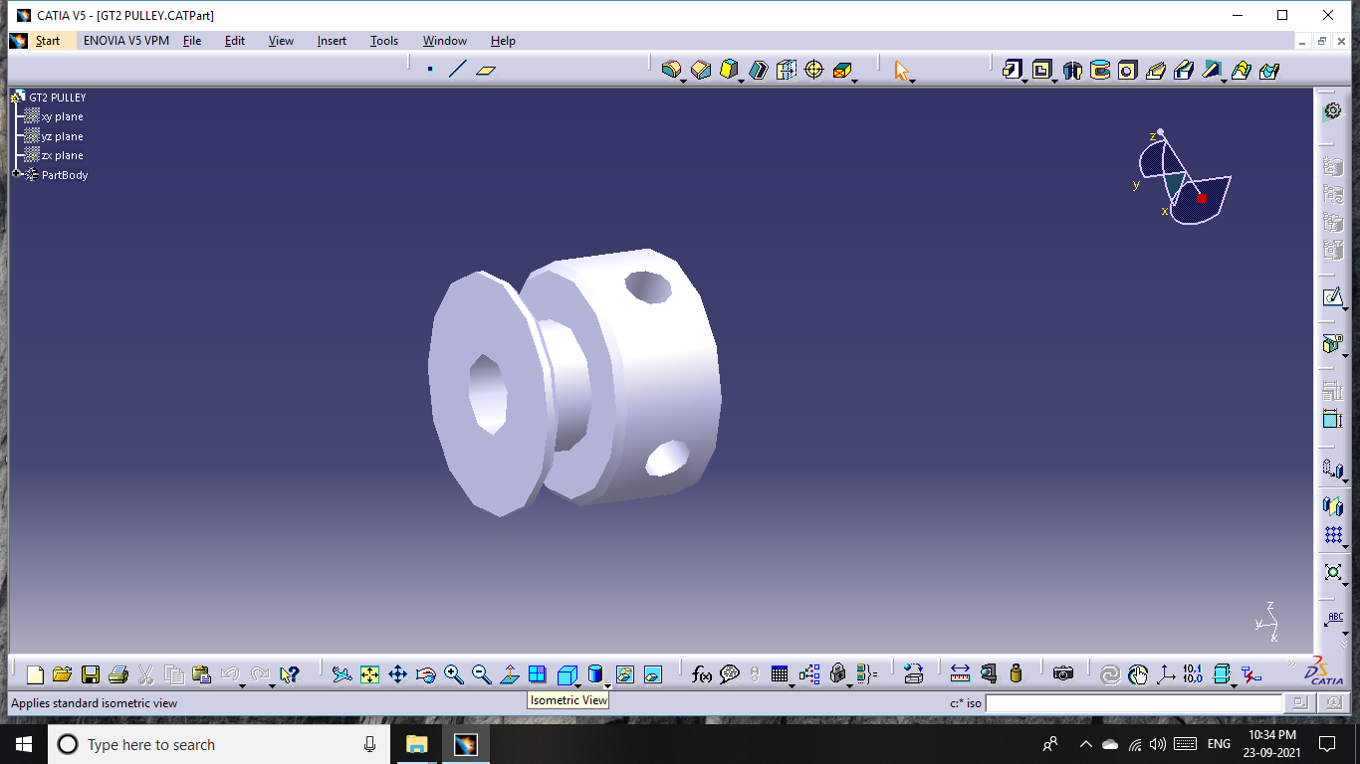
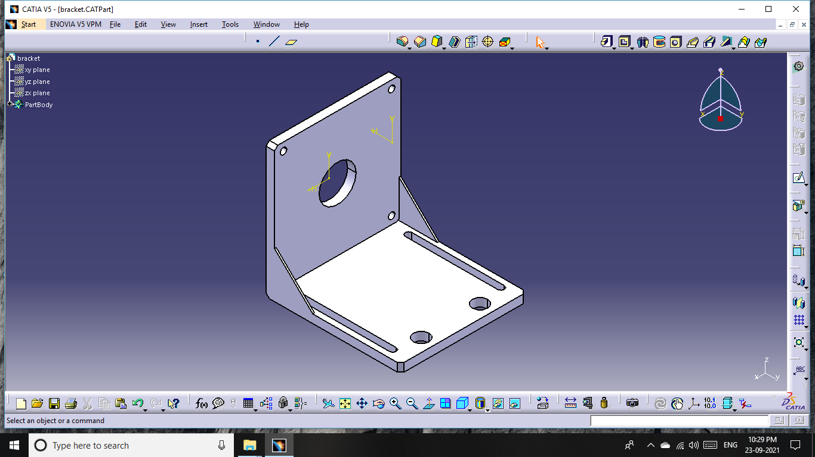
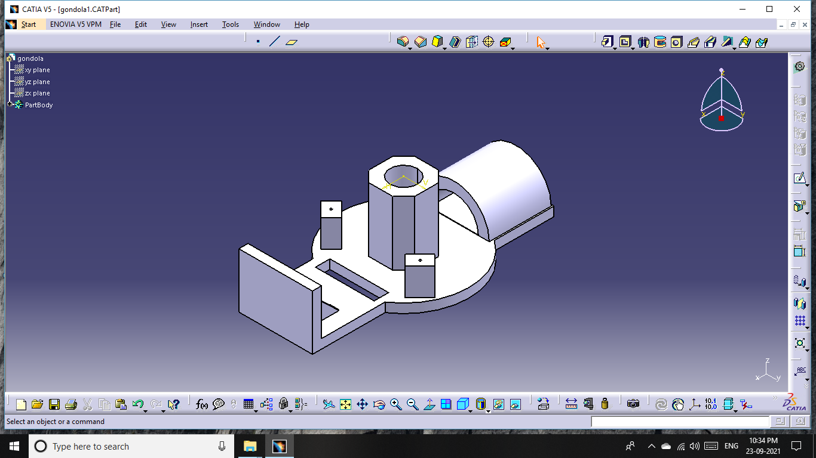

Slide 17
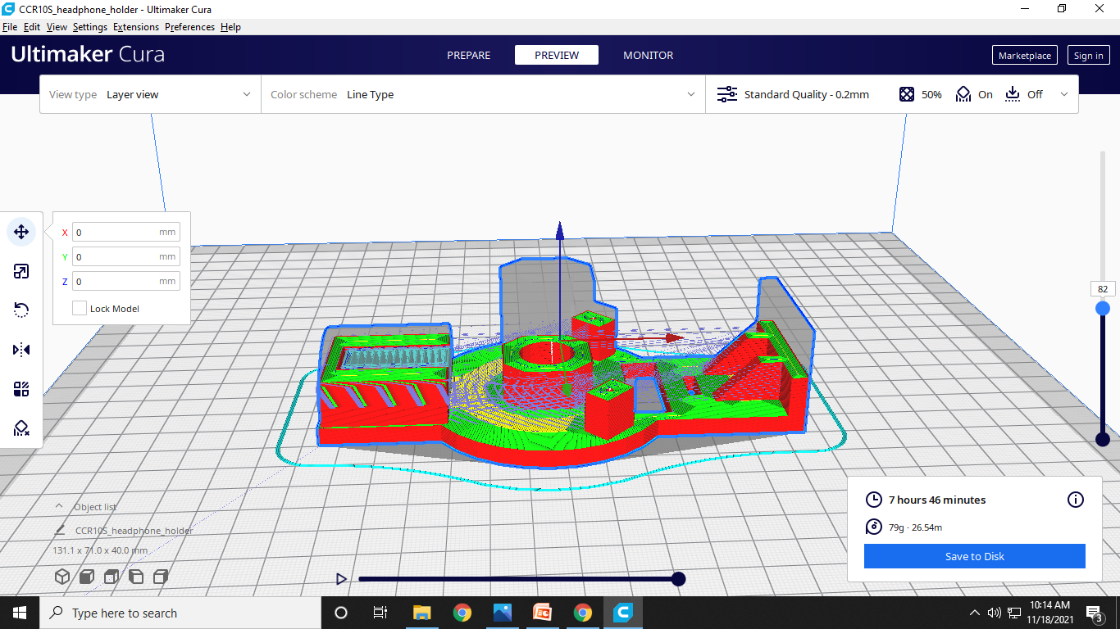
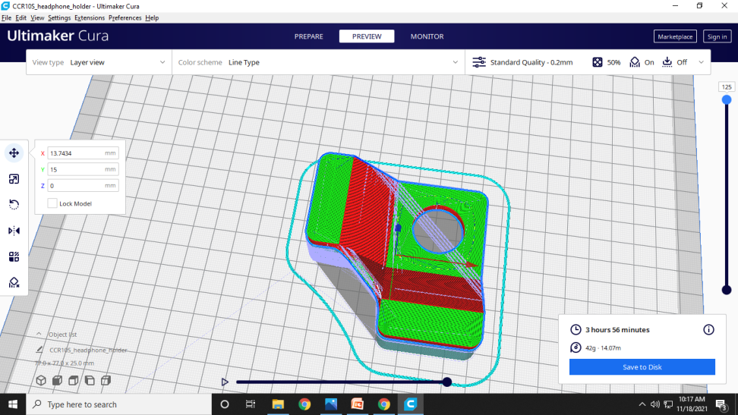
3D Printing parts preparation using software : Ultimaker Cura

Slide 18
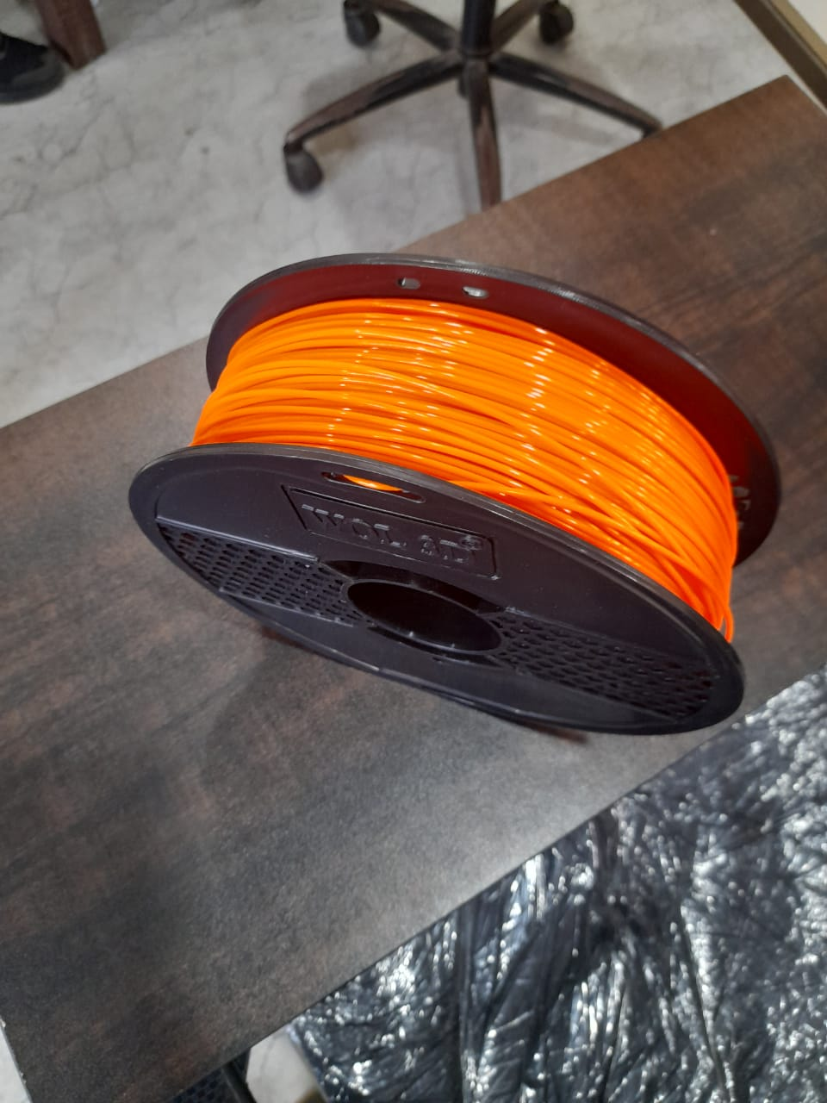
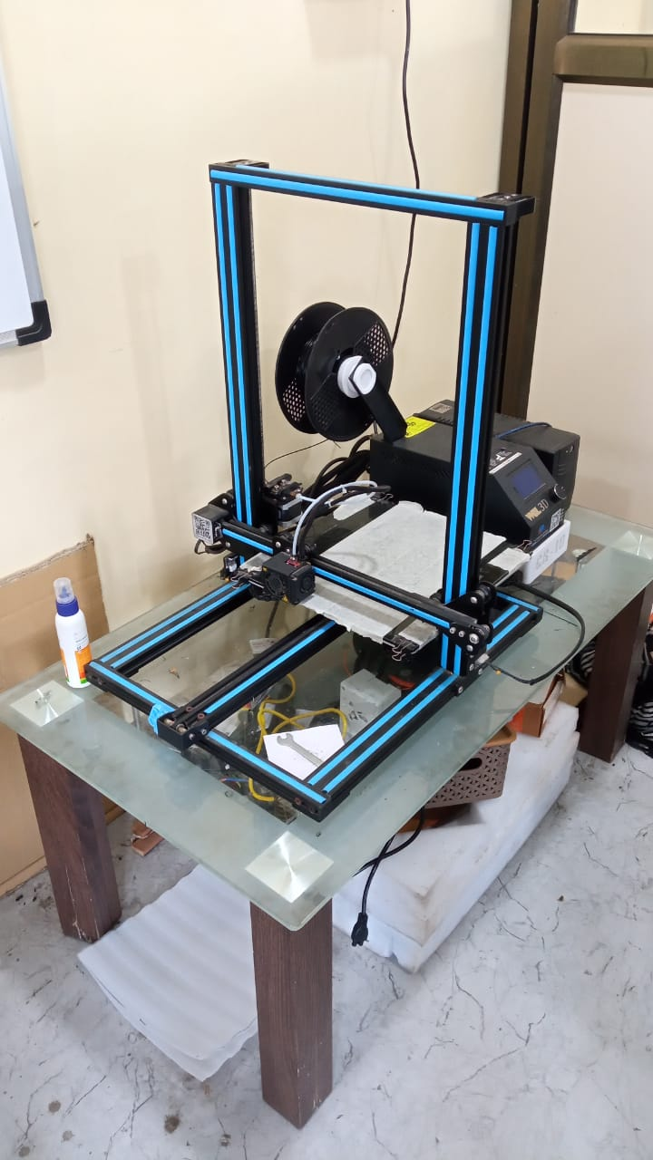
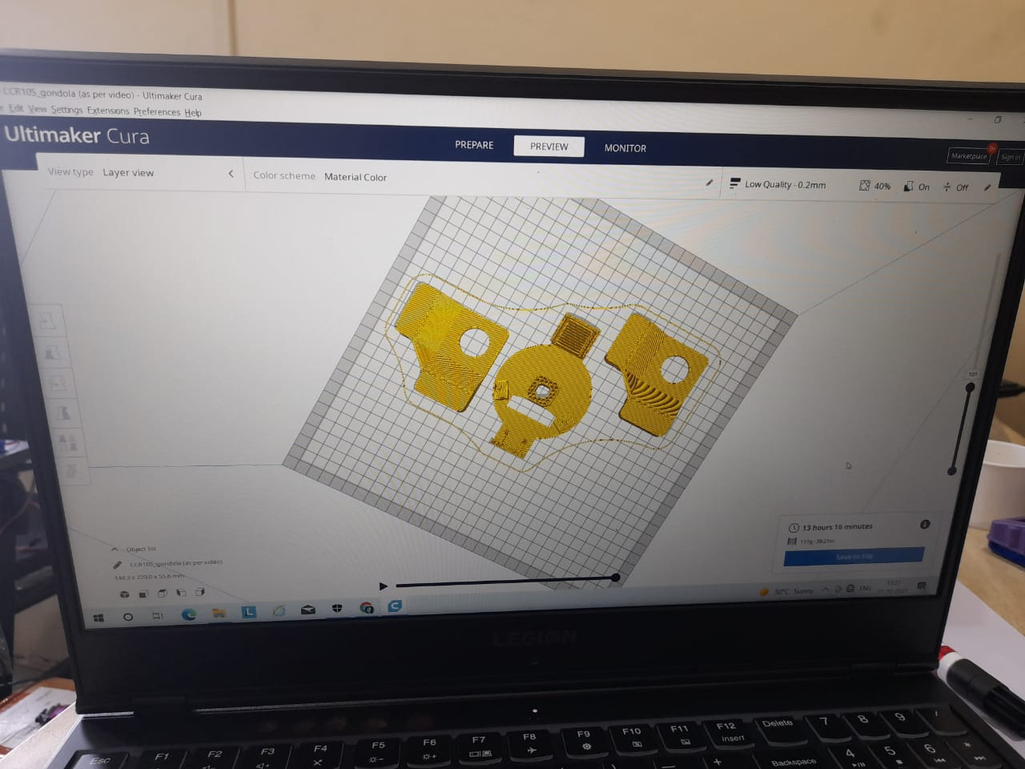
MOC : PLA+

Slide 19
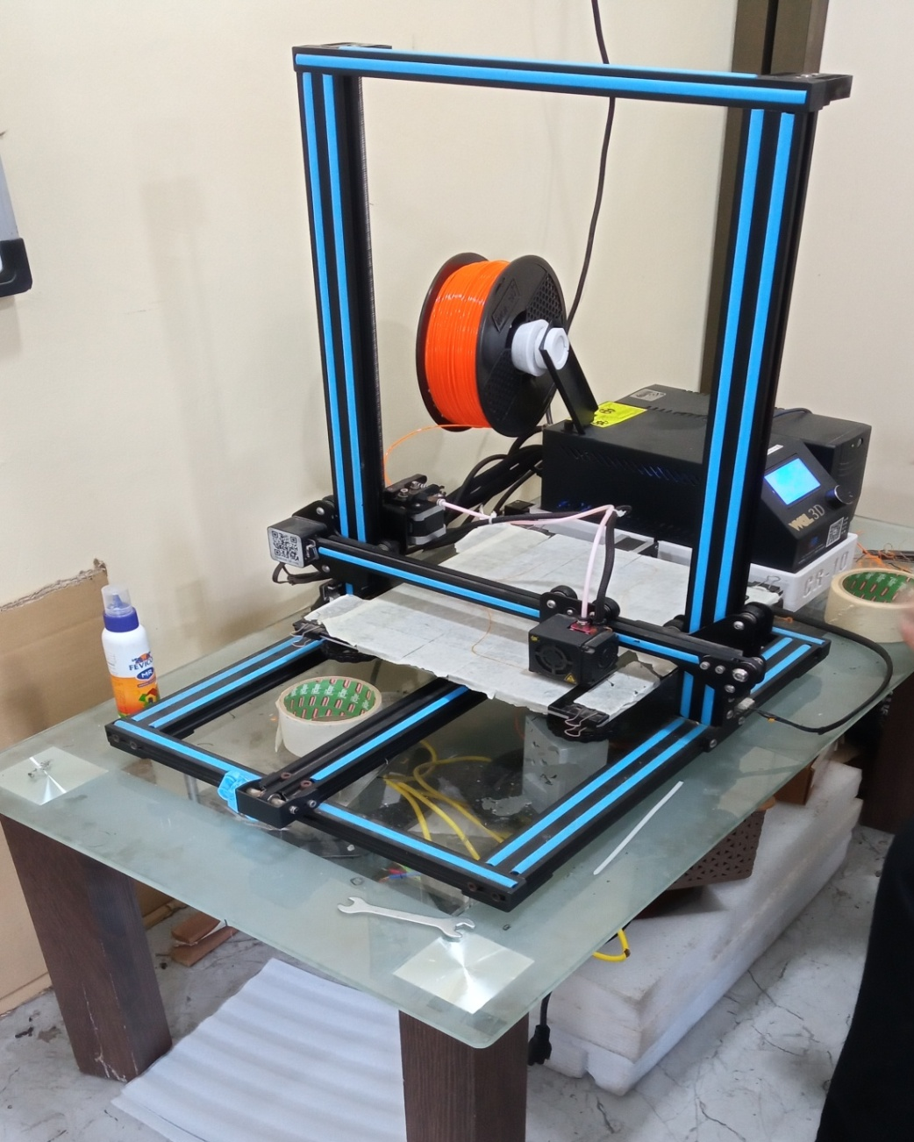
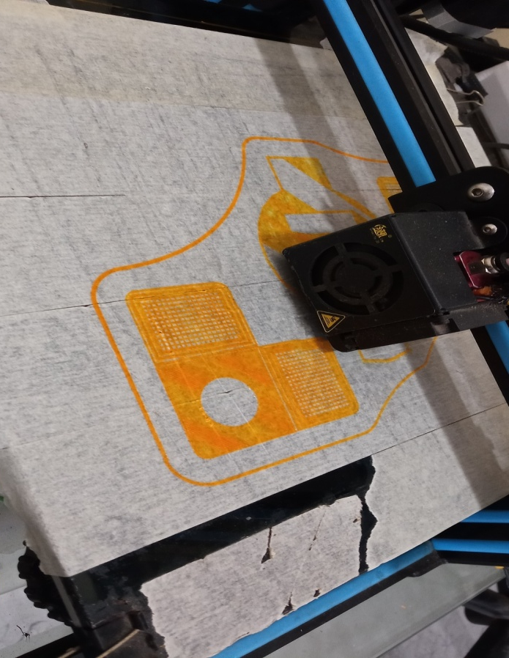
3D Printing of Support brackets

Slide 20
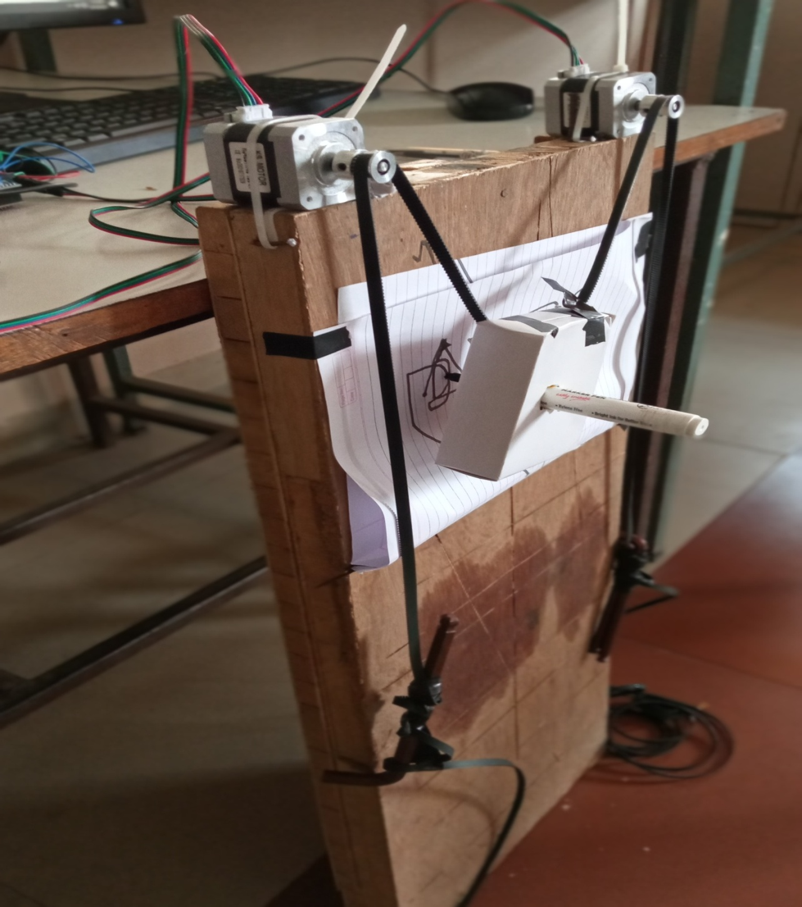
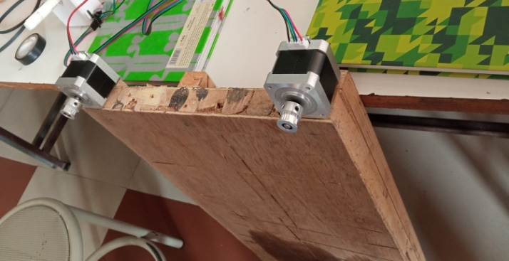
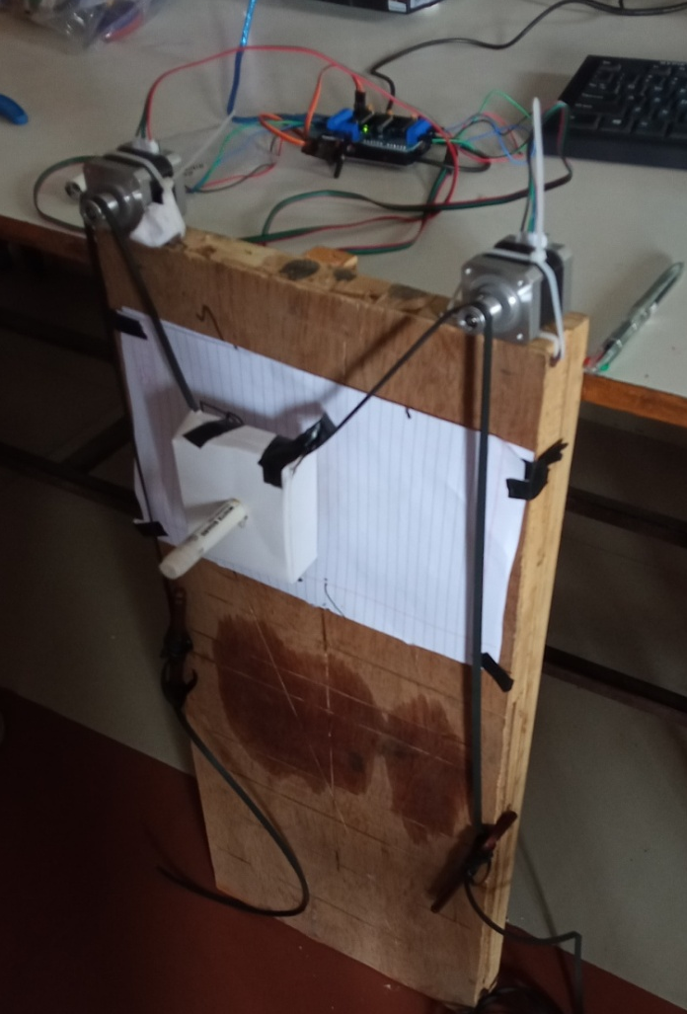
Some pictures of Trials

Slide 21
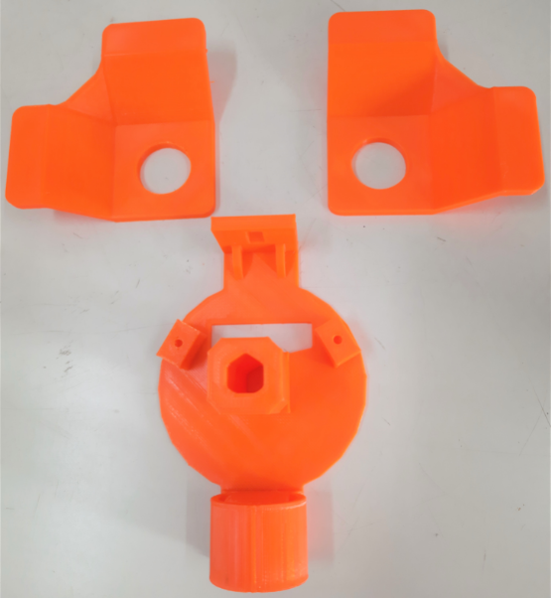
3D Printed pen holder & support bracket

Slide 22


Slide 23
Stl file
Qura
3d printing pics and visit pics
Pics of prototype
Material collection

